Slide 1

144414516
144414516
144414516
152374308
152374308
148838828
148792292
153196572
150670292
222682948
222682948
138576036
48879496
  Smart City Workshop
  Digitalization in our daily life
  Date: 12.04.2018 (Thursday)
  Time: 14:00 – 19:45 incl. Dinner
  Place: University of Žilina,
  Faculty of Management Science & Informatincs (FRI)
  Capacity: Limited (max. 20 slots)

Slide 2
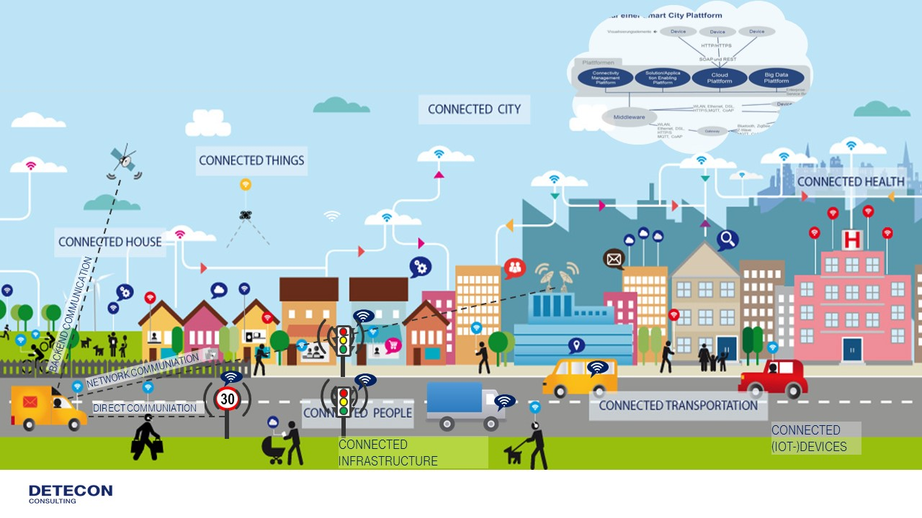
A Smart City is at the convergence of politics, policies, IOT, Big Data and Cloud. It is the digitalization of the urban space

Slide 3
Agenda
01 | The central question: what is a smart city ?
02 | The technology perspective | Examples @ Deutsche Telekom
 |  | Smart City Framework
 |  | Smart City Architecture Blueprint
 |  | Use Cases and associated devices
 |  | Access Technologies
 |  | Protocols
 |  | Standards
03 | The business perspective | Addressable market
 |  | The Value Chain
 |  | The Players
04 | Examples of Smart cities Worldwide
05 | Detecon as a partner for Smart City Projects
06 | Conclusion

Slide 4
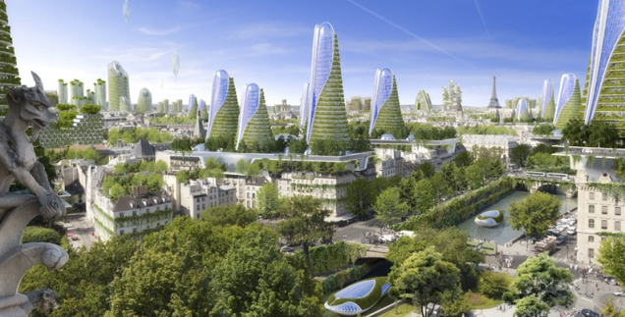
After this workshop, we would like you to …
Know what the aim of a Smart Cities can be, besides from a nice technologic challenge
Know major use cases and technologies involved in Smart Cities
Have an overview on the Smart Cities market
Understand the challenges of the current, actual Smart Cities implementations

